Slide 1


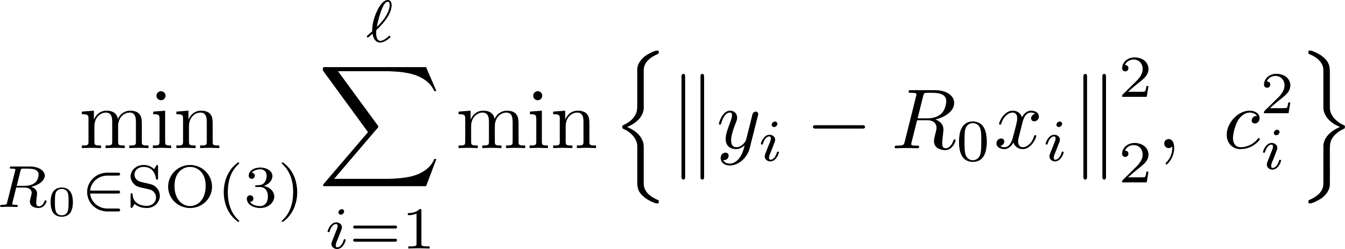
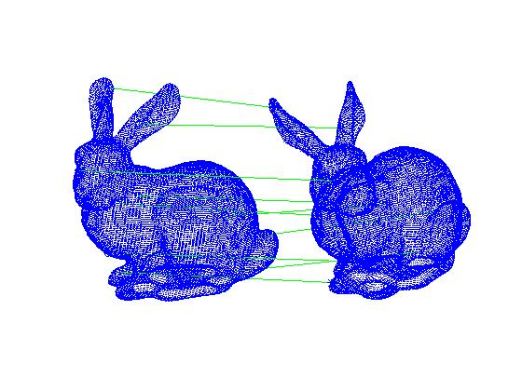
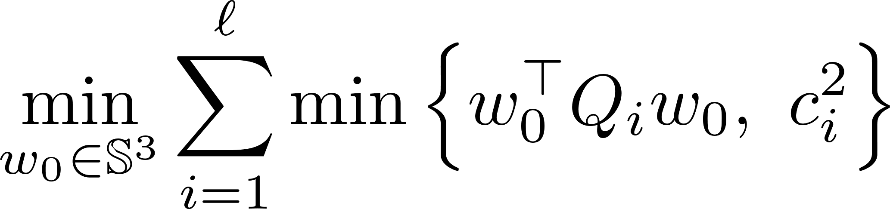
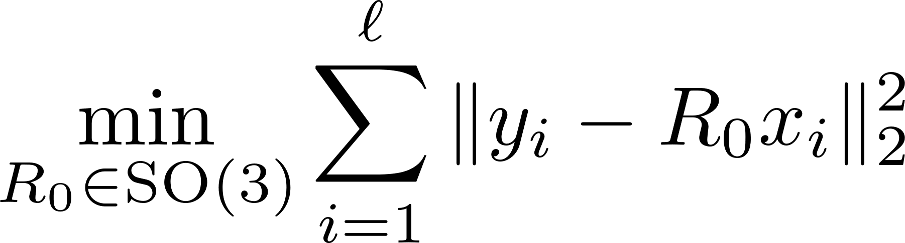
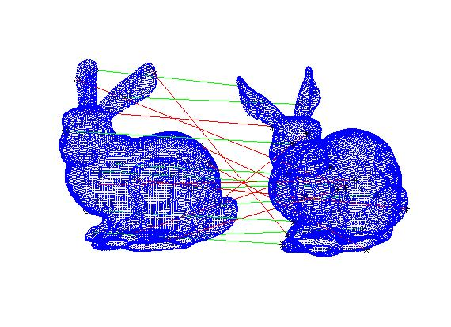
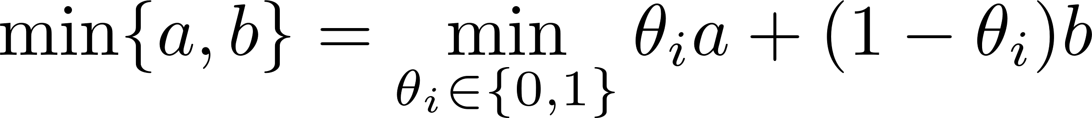
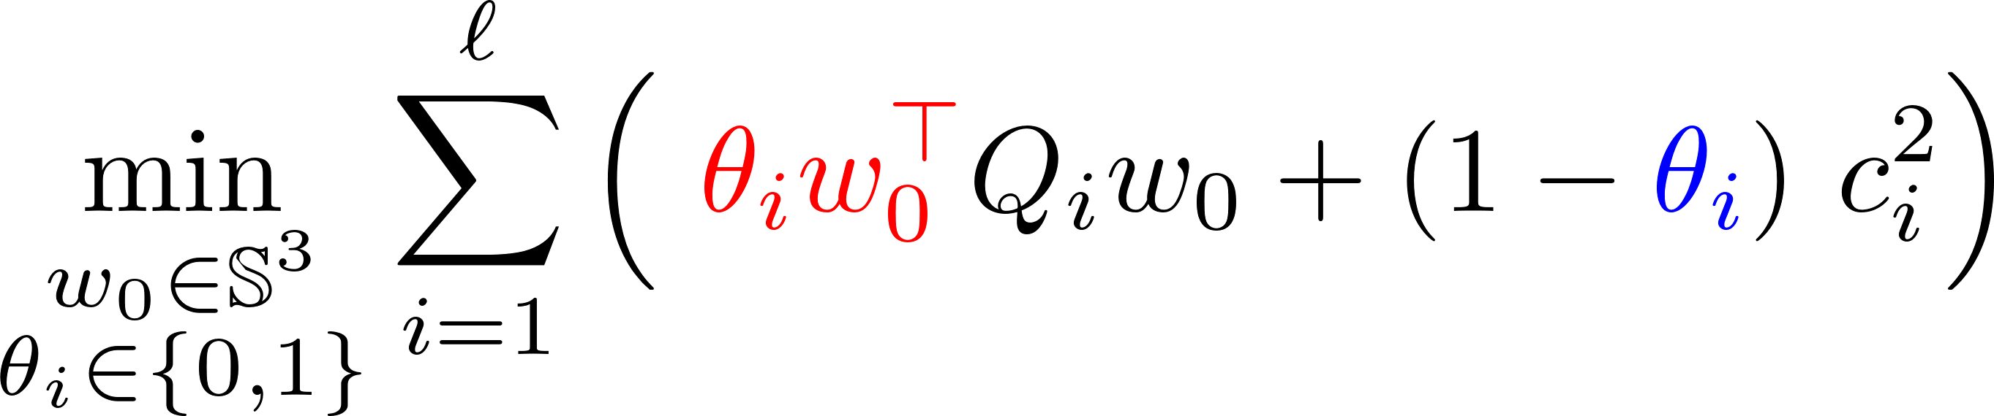
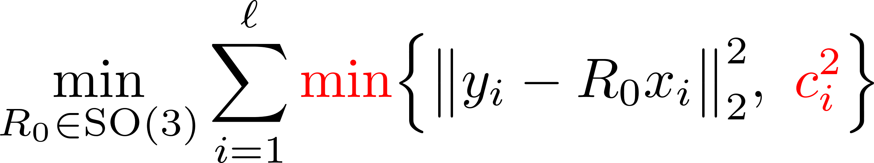
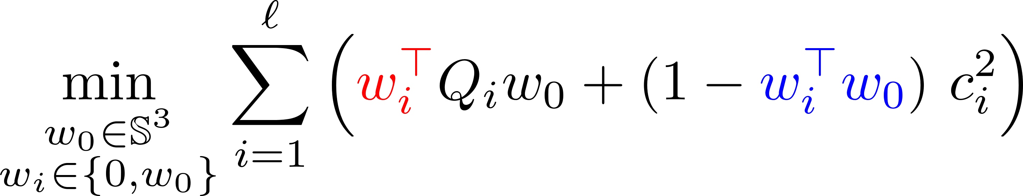
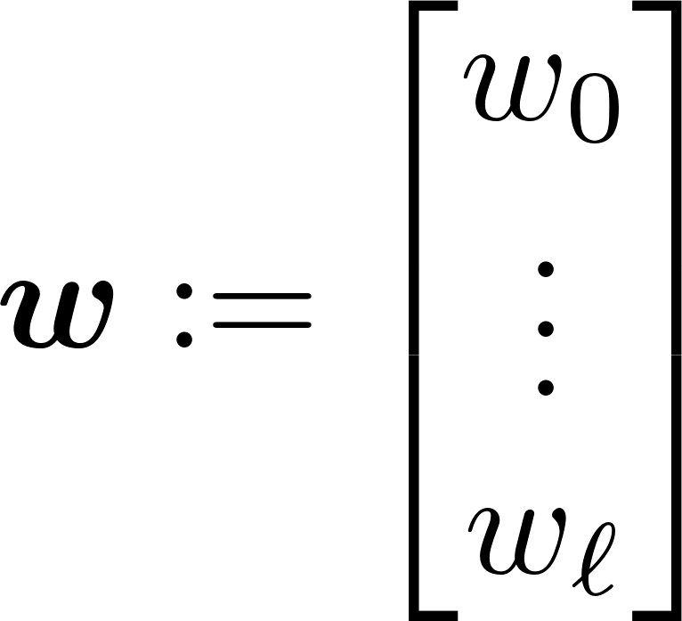
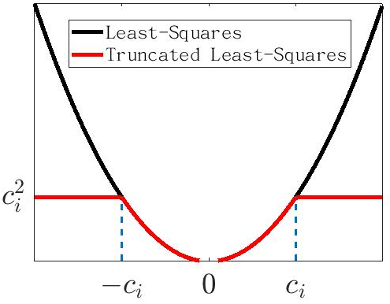
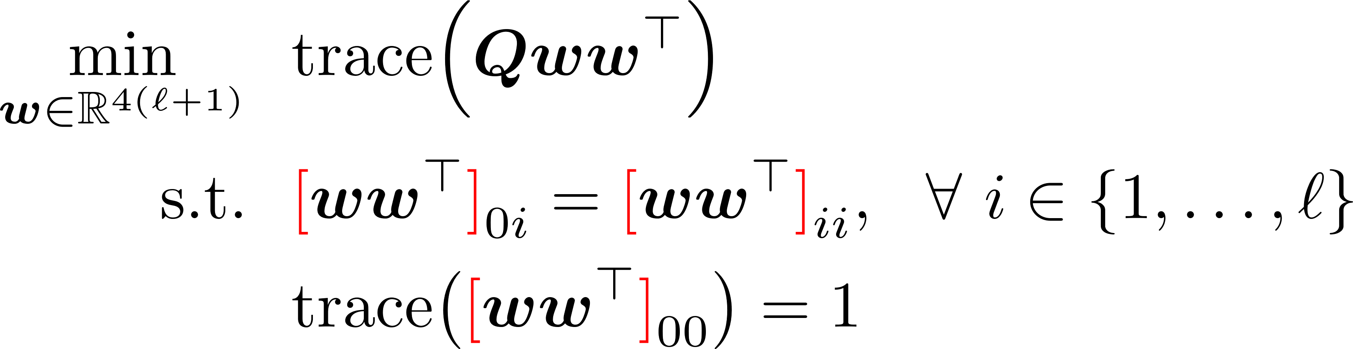
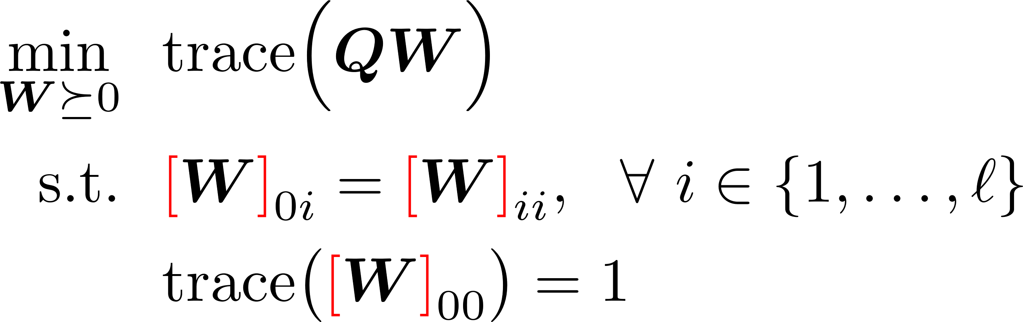

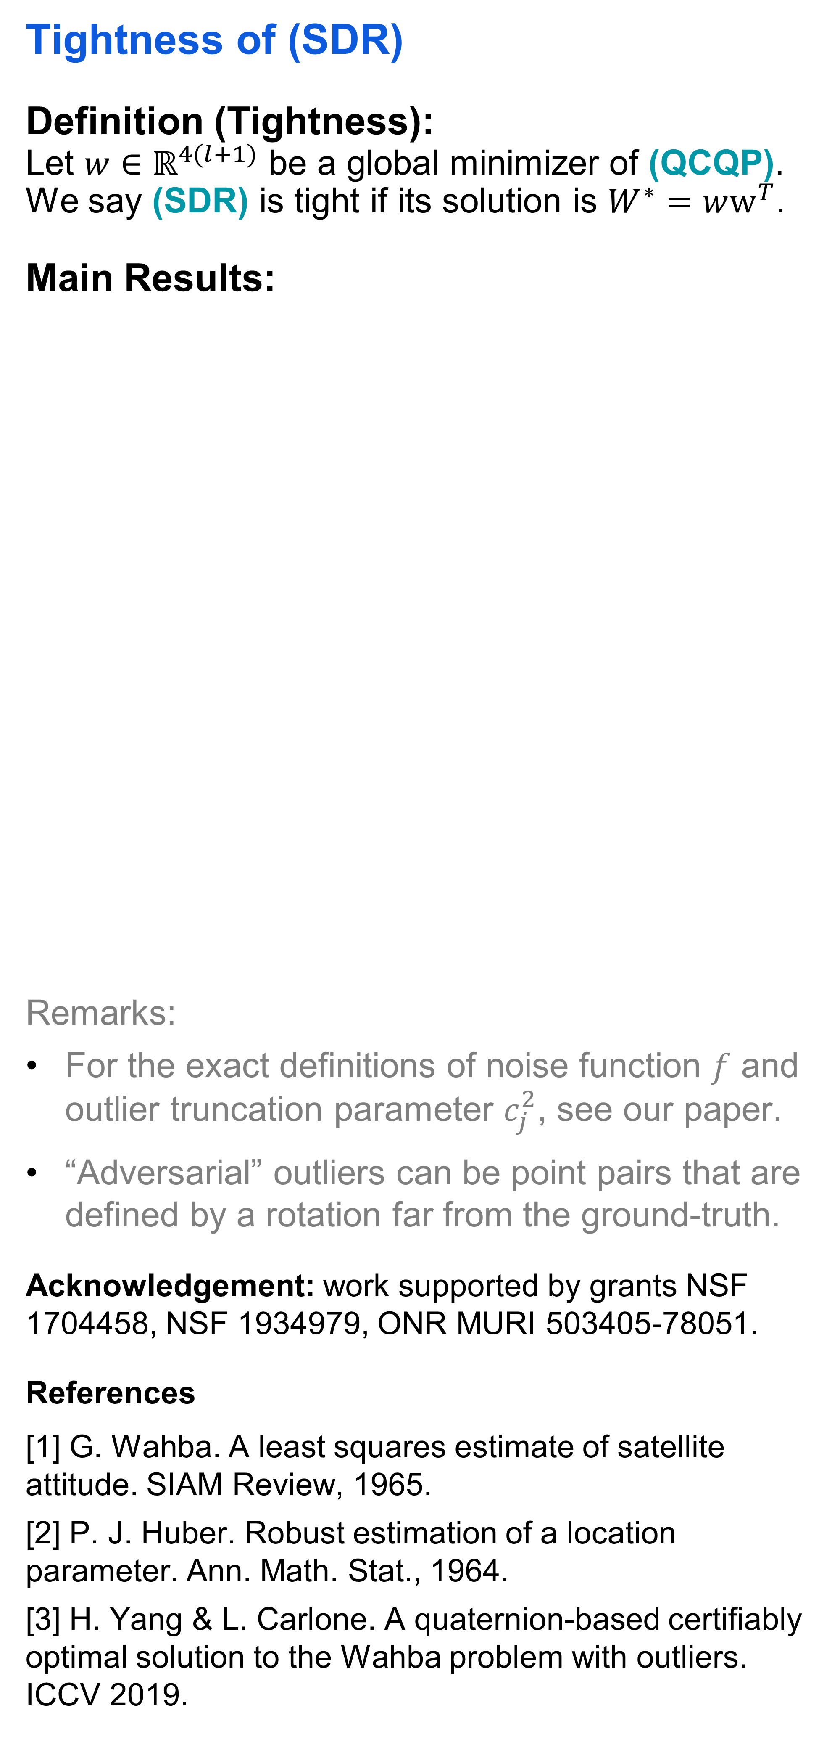
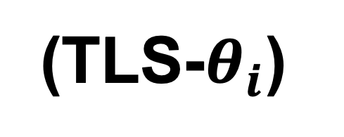

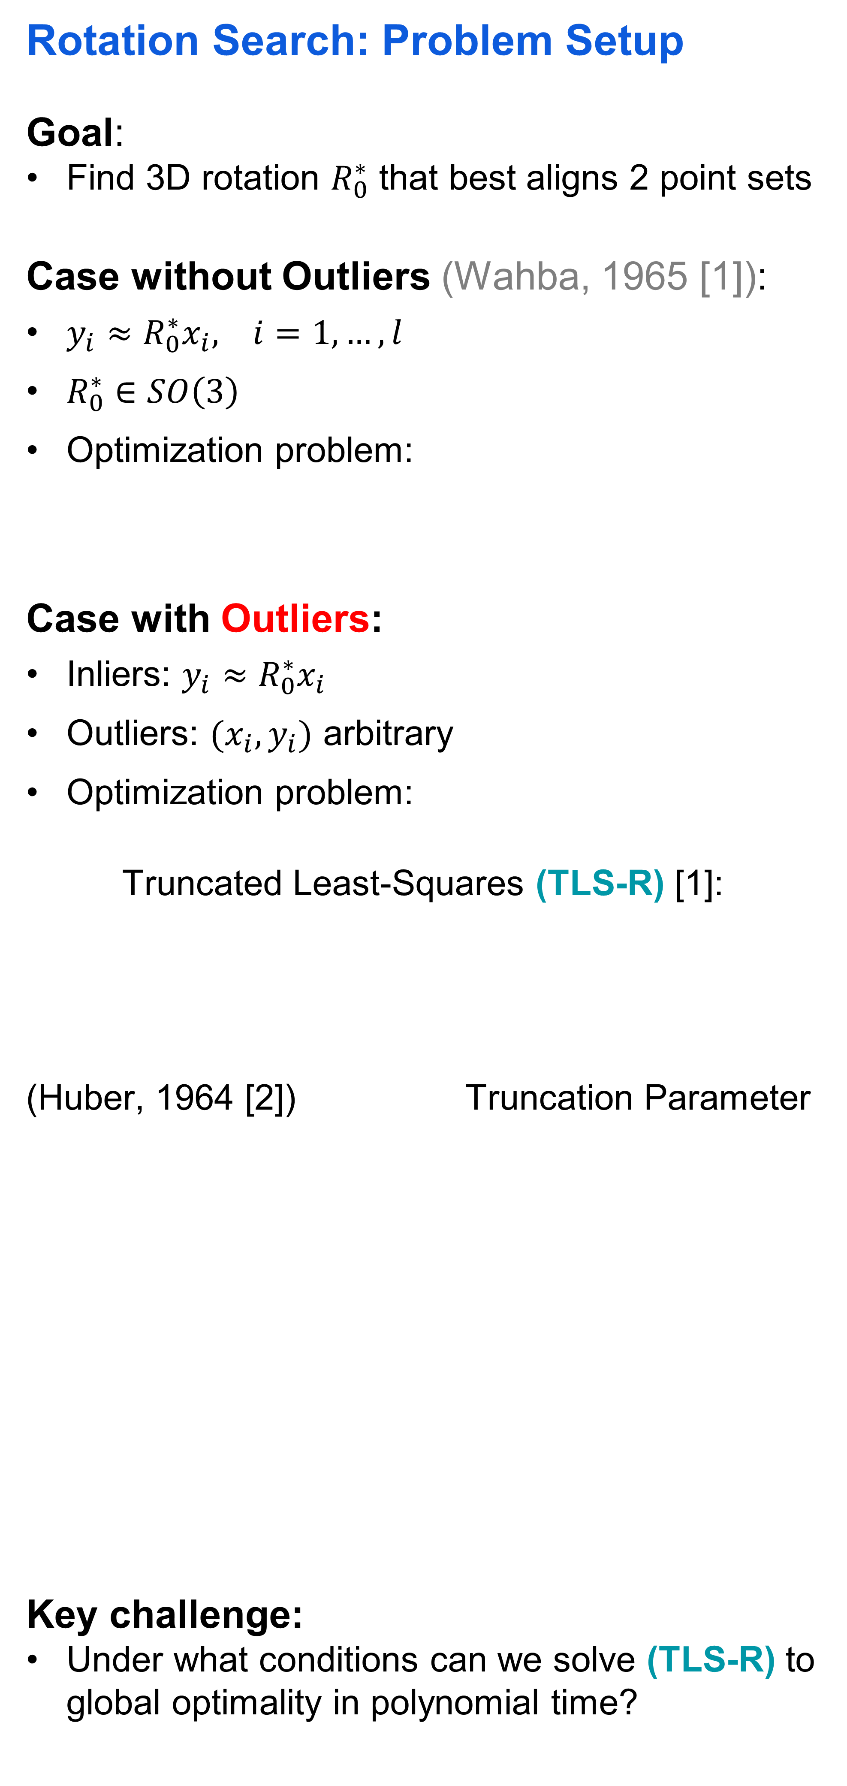
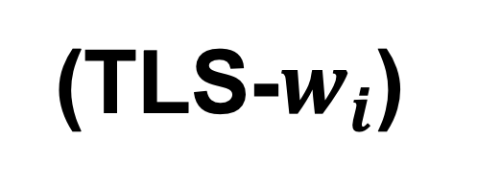
Semidefinite Relaxations of Truncated Least-Squares in Robust Rotation Search: Tight or Not
Liangzu Peng, Mahyar Fazlyab, René Vidal
Rotation Search: Problem Setup
Goal:
Find 3D rotation $R_{0}^{∗}$ that best aligns 2 point sets
Case without Outliers (Wahba, 1965 [1]):
${{y_{i}≈R}_{0}^{∗}x}_{i}, i=1,…,l$
$R_{0}^{∗}∈SO\left(3\right)$
Optimization problem:
Case with Outliers:
Inliers: ${{y_{i}≈R}_{0}^{∗}x}_{i}$
Outliers: $(x_{i},y_{i})$ arbitrary
Optimization problem:
Truncated Least-Squares (TLS-R) [1]:
(Huber, 1964 [2]) Truncation Parameter
Key challenge:
Under what conditions can we solve (TLS-R) to global optimality in polynomial time?
From (TLS-R) to Semidefinite Relaxations (SDR)
(TLS-R) $\underset{⇔}{(1)}$ (TLS-Q) $\underset{⇔}{\left(2\right), (3)}$ (QCQP) $\underset{⇒}{\left(4\right) lifting}$ (SDR)
Step (1): 3D rotations $R_{0} \overset{⇔}{ }$ unit quaternions $w_{0}$
Step (2):
Step (3):
Step (4): From (QCQP) to (SDR)
Tightness of (SDR)
Definition (Tightness):
Let ${w∈ℝ}^{4(l+1)}$ be a global minimizer of (QCQP). We say (SDR) is tight if its solution is $W^{∗}=ww^{T}$.
Main Results:
Remarks:
For the exact definitions of noise function $f$ and outlier truncation parameter $c_{j}^{2}$, see our paper.
“Adversarial” outliers can be point pairs that are defined by a rotation far from the ground-truth.
Acknowledgement: work supported by grants NSF 1704458, NSF 1934979, ONR MURI 503405-78051.
References
[1] G. Wahba. A least squares estimate of satellite attitude. SIAM Review, 1965.
[2] P. J. Huber. Robust estimation of a location parameter. Ann. Math. Stat., 1964.
[3] H. Yang & L. Carlone. A quaternion-based certifiably optimal solution to the Wahba problem with outliers. ICCV 2019.
(TLS-R)
Positive Result
Inlier Assumption: We have $c_{i}^{2}>f(noise)$ for every inlier point pair ${(y}_{i},x_{i})$. Here $f$ is a complicated function of noise with $f\left(0\right)=0$.
Outlier Assumption: Each outlier pair ${(y}_{j},x_{j})$ is drawn independently and randomly from $ℝ^{3}×ℝ^{3}$ according to some continuous probability distribution, and $c_{j}^{2}$ is set small enough.
Under the Inlier and Outlier Assumption,
(SDR) is tight.
(1)
(TLS-Q)
(2)
(TLS-$θ_{i}$)
(3)
Negative Result
(SDR) is not tight for “adversarial” outliers.
(TLS-$w_{i}$)
(QCQP)
(4)
(SDR)

